Slide 1
ACHE
California Association of Healthcare Leaders
Membership
Advancement
Affiliate Advancement Introduction
Notes:
1

Slide 2
Overview
Introduction: CAHL Advancement Committee Members
Affiliate Advancement Overview
What Does Credentialing Mean For Me?
BOG Exam
Eligibility/ Requirements
How Do I Apply? What is the Process?
Timeline
Recertification
Resources
Benefits of CAHL Membership
Questions/Comments

Slide 3
Committee Members
Nora Powers, MHA, Co-Chair
Director of Provider Contracting
Anthem Blue Cross
Nora.powers@wellpoint.com
Mike Brokloff, MS, MBA
Director of Service
GE Healthcare
Narendra Desai
Clinical Laboratory Scientist
Natividad Medical Center
Aaron Chang, MHA, Co-Chair
Business Operations Manager
Ambulatory Care Clinics
Lucile Packard Children's Hospital
achang@lpch.org
Kathryn Simpson
Consultant
Palo Alto Medical Foundation
Jerry Birk, MHA, FHFMA
VP, Cardiovascular & Thoracic Svcs
Rideout Health

Slide 4
Affiliate Advancement Process Overview:
What does credentialing mean for me?
The ACHE Fellow credential is not only a mark of prestige, but also an indicator that you are willing to work hard, hold yourself to high ethical standards, and that you've made a conscious choice to be a leader in our industry.
Senior executive testimonials regarding the value of achieving the FACHE available on the CAHL website.
http://cahl.ache.org/affiliate-advancement.html

Slide 5
Affiliate Advancement Process Overview:
Board of Governors (BOG) Exam
Ten Areas Covered:
Governance & Organizational Structure, Human Resources, Finance, Health care Technology & Information Management, Quality & Performance Improvement, Laws & Regulations, Professionalism & Ethics, Healthcare, Management, Business
Timing/Questions:
Allotted up to 6 hours to complete exam
230 questions: 200 are scored and 30 are pretest questions (pretest questions do not affect a candidate’s score.
No penalty for incorrect answers
Scoring:
A modified Angoff Method is used to determine the pass point for the Board of Governors exam.
Pass or Fail
Fees:
Exam enrollment fee—$250
Exam registration fee—$200
http://www.ache.org/mbership/credentialing/EXAM/EXAM.cfm#overview

Slide 6
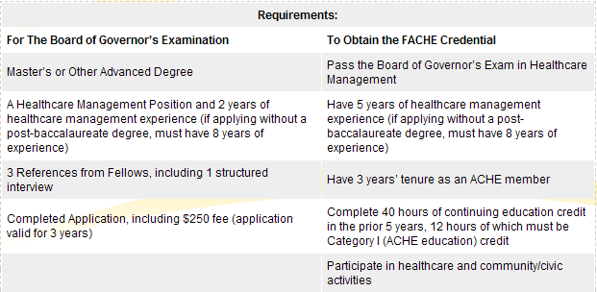
Affiliate Advancement Process Overview:
Eligibility/Requirements

Slide 7
How Do I Apply? What is the Process?
Affiliate Advancement Process Overview:
(1) Fulfill Board of Governors (BOG) Exam Eligibility requirements:
Masters or other Post Baccalaureate Degree
Complete and Submit (electronically or via mail) FACHE Application with required supplementary information
Healthcare management position + > 2 years management experience
(2) Receive authorization letter and exam registration form from ACHE
(3) Within 3 years, complete the following:
Prepare for, take, and pass Board of Governors Examination
Meet any remaining requirements to earn FACHE credential:
Healthcare management position + 5 years management experience
ACHE member for 3 years
40 hours of continuing education
12 of which are ACHE Category I (Face-to-Face) education hours;
28 can be ACHE Category I) or ACHE Category II (non-ACHE sources)

Slide 8
Timeline
Affiliate Advancement Process Overview:
Applications may be submitted anytime during the year.
Two options available
Pen & Paper exam offered at ACHE’s annual Congress on Healthcare Leadership in March.
2) Computer-Based Testing available through Prometic
Exam must be completed within 90 days of paying exam fee, whichever option is chosen

Slide 9
New Fellow Timeline
Affiliate Advancement Process Overview:
Advancement Year
New Fellow application submitted between now and Dec 31, 2013
New Fellow application submitted after January 1, 2014
Education Requirements
40 hours Continuing Education credits over previous 5 years: 12 hours must be ACHE Cat I (Face-to-Face) credits; balance may be either Cat I or Cat II (Non-ACHE) Qualified Education credits
36 hours Continuing Education credits over previous 3 years: 12 hours must be ACHE Category I (Face-to-Face) credits; balance may be either Cat I or Cat II (Non-ACHE) Qualified Education credits

Slide 10
Fellow Recertification
Affiliate Advancement Process Overview:
Recertification is required every three years – ACHE will notify of eligibility to recertify
Requirements include participation in two healthcare activities & two community/civic activities
Plus
Completion of 24 hours of Continuing Education credits OR Retake & pass BOG Exam

Slide 11
New Fellow Recertification Timeline
Affiliate Advancement Process Overview:
Recertification Year
Fellow Recertification application submitted between now and Dec 31, 2013
Fellow Recertification application submitted after January 1, 2014
Education Requirements
24 hours Continuing Education credits over previous 3 years: 12 hours must be ACHE Cat I (Face-to-Face) credits; balance may be either Cat I or Cat II (Non-ACHE) Qualified Education credits
36 hours Continuing Education credits over previous 3 years: 12 hours must be ACHE Category I (Face-to-Face) credits; balance may be either Cat I or Cat II (Non-ACHE) Qualified Education credits

Slide 12
Resources
Chapter Advancement Study Groups
LinkedIn Study Group (CAHL Group)
Watch for Social Media Updates on LinkedIn and Facebook
ACHE Fellow Advancement Webinars
-Schedule available on ACHE.org website
Board of Governors (BOG) Examination Review Course
-ACHE
-CAHL 2-day Study/Review Session – Location/Date to be announced soon
Study Materials Purchase and Circulation
Books available on loan through CAHL Chapter (Contact Aaron Chang), or
available through Health Administration Press
Websites:
http://cahl.ache.org/affiliate-advancement.html
LinkedIn: California Association of Healthcare Leaders/ACHE
CAHL LinkedIn Subgroup: FACHE Study Group

Slide 13
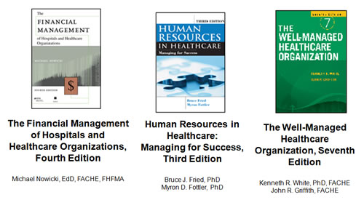
Resources
Study Materials Purchase and Circulation
Books are available on loan through CAHL Chapter (Contact Aaron Chang), or available through Health Administration Press (check website for current price)

Slide 14
Benefits of ACHE / CAHL Membership
Through these benefits, healthcare management professionals can advance their knowledge and skills, making them more effective leaders:
Networking Opportunities
Educational and Executive Seminars
Career Services
National Congress on Healthcare Leadership
Advancement Support for Premier Credential (FACHE)
Publications
Ethical decision-making

Slide 15
Benefits of ACHE / CAHL Membership
Advancement Support for Premier Credential (FACHE)
> Active Advancement and Membership Committee
-“90-Day Challenge”
-Structured Support from Active Interest thru BOG Exam
-Two-day BOG Exam Review and Study Session
-Will include speakers and presentations
-To be held in Sacramento
- Date to be announced soon
-LinkedIn FACHE Study Group
-Interaction & Communication with fellow CAHL Members
and FACHE candidates

Slide 16
Questions and Comments

